Slide 1


C# ASP.NET MVC (Code First)
March 2018

Slide 2
MVC ARCHITECTURE

Slide 3
MVC ARCHITECTURE
MVC separates application into three components - Model, View and Controller.
Model: Model represents shape of the data and business logic. It maintains the data of the application. Model objects retrieve and store model state in a database
Model is a data and business logic.

Slide 4
MVC ARCHITECTURE
MVC separates application into three components - Model, View and Controller.
View: View is a user interface. View display data using model to the user and also enables them to modify the data.
View is a User Interface.

Slide 5
MVC ARCHITECTURE
MVC separates application into three components - Model, View and Controller.
Controller: Controller handles the user request. Typically, user interact with View, which in-tern raises appropriate URL request, this request will be handled by a controller. The controller renders the appropriate view with the model data as a response
Controller is a request handler.

Slide 6
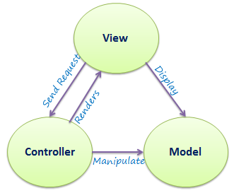
MVC ARCHITECTURE

Slide 7
DEMO

Slide 8
Routes

Slide 9
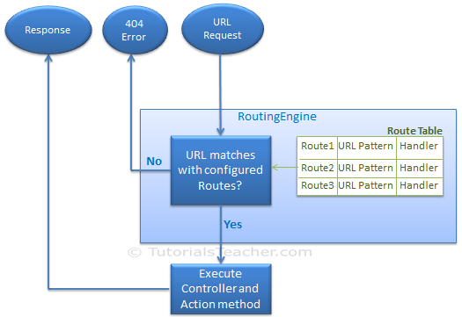
Routes
Route defines the URL pattern and handler information. All the configured routes of an application stored in RouteTable and will be used by Routing engine to determine appropriate handler class or file for an incoming request.

Slide 10
Controllers

Slide 11
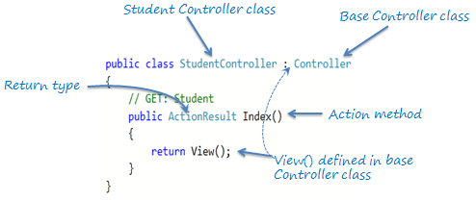
Controllers
All the public methods of a Controller class are called Action methods. They are like any other normal methods with the following restrictions:
Action method must be public. It cannot be private or protected
Action method cannot be overloaded
Action method cannot be a static method.

Slide 12
Controllers
Action selector is the attribute that can be applied to the action methods. It helps routing engine to select the correct action method to handle a particular request. MVC 5 includes the following action selector attributes:
ActionName
NonAction
ActionVerbs

Slide 13
Controllers
The ActionVerbs selector is used when you want to control the selection of an action method based on a Http request method. For example, you can define two different action methods with the same name but one action method responds to an HTTP Get request and another action method responds to an HTTP Post request.

Slide 14
Models

Slide 15
View

Slide 16
View
View file extension | Description
.cshtml | C# Razor view. Supports C# with html tags.
.vbhtml | Visual Basic Razor view. Supports Visual Basic with html tags.
.aspx | ASP.Net web form
.ascx | ASP.NET web control

Slide 17
How to work with Entity Framework

Slide 18
How to work with Entity Framework
Install entity framework using the Tools > NuGet Package Manager > Package Manager Console then typing:
Install-Package EntityFramework
Update Web.Config file to specify the connection string. Make sure the Context name is similar to the connectionString name
Enable the migration. This will add the Migration folder and Configuration file.
Enable-Migrations
Create initial migration to the Database by running this command
Add-Migration <nameofmigrationfile>
Run the migration and seed by running the update database command
Update-Database
Note: any changes to the models you need to add new migration file and update database again. Incase you get errors for complicated changes that you made you can delete all the files in Migration folder except the configuration file, delete the database in management studio and start from step 4 again.

